Slide 1
A Resolution for Inaccessibility
By Trevor Barrow

Slide 2
The Issue at Hand
There is an inherent inaccessibility within government resolutions to the layman due to the highly technical language and complexity of topics at hand
The layman is neither trained nor used to interpreting such language or such dense levels of information
While many resolutions are generally less than 20 clauses, many reach up to 50 and even beyond 100
The literal size of such resolutions due to their length is incredibly overwhelming to those who aren’t familiar with them
Facing such an overwhelming amount of unfamiliar information keeps people from being able to efficiently comprehend and retain much of it
This has led to a normalization of political apathy via inaccessibility

Slide 3
Pulling the Solution from the Problem (The Product)
Created a model to bridge the skill gap
Model takes in a pre-processed resolution txt document and ‘topic amount’ value
Model returns a product comprised of determined topic phrases and (2 * topic amount) clauses from the resolution
The returned clauses have been chosen as they best represent their individual topic subsets
Overall product ensures that the overall ideas and stances within the resolution are presented as accurately and with as much information maintained as possible
Effectively condenses resolution to key points

Slide 4
Value to the Layman
A SparkNotes-esque version of resolutions allows for one to focus on keypoints and understand the overall topics and stances at hand without becoming overwhelmed
Allows readers to take in and retain information at their own pace as opposed to feeling like they need to take in all information at once
Will help to easen political apathy by allowing the layman a jumping-off point from which they may become further interested and familiar with technical writing and legislative matters

Slide 5
Value to Students
Can be used specifically in middle and high school government courses to help students understand certain matters in resolutions without overwhelming them
Can be used as either a study tool or answer sheet in helping students to effectively summarize and points out the topics and stances found within highly-technical, information-dense writing
Regardless of if a student pursues a government position in the future, this model as a learning tool will help them to build their reading comprehension and ability to parse dense information
These skills, when cultivated at a young age, will greatly aid students through the rest of their educations and lives

Slide 6
Tools Employed
Pandas
Natural Language Toolkit (nltk)
TextRank
Bag of Words
Term frequency-individual document frequency (tf-idf)
Support Vector Machine (SVM)
Clustering Algorithm (t-SNE)

Slide 7
The Two Parts of a Resolution
The ‘Whereas’ Section
Comes first
All clauses start with ‘Whereas’
Each clause presents a piece of evidence relevant to the topic(s) at hand
Acts as the platform for which the clauses in the ‘Resolved’ section are justified
The ‘Resolved’ Section
Comes second
Each clause presents a ‘call to action’ or solution towards the topic(s) at hand
As a whole, intends to resolve or promote an issue or stance on the topic(s) at hand

Slide 8
The Model
Examples shown are using Senate Resolution 34, condemning Myanmar’s abuse of the Rohingya people, with Topic Amount = 4

Slide 9
The Two Inputs
The Pre-Processed Resolution
A .txt document of the resolution
Requires pre-processing due to the text formatting used by the sites from which the resolutions were taken from causing instant Python reading errors
Pre-processing removes error-causing indentation and line breaks
The Topic Amount
A user-given integer greater than 1
Acts as the value for how many topics the resolution will be partitioned into
The model will work to find one ‘Whereas’ clause and one ‘Resolved’ clause per each topic
Thus, the final product has one of each clause type per topic if available
n = 2 - 4 gives best results and validation metrics
n > 4 causes topic overfitting and a less useful final product

Slide 10
Text Processing and Initial Dataframe Creation
.txt document is opened, set to a variable, then split and joined with a space between items to remove any excess whitespace
Text is split into two strings ‘whereas’ and ‘resolved’ based on the phrase “Now, therefore, be it Resolved,” which is directly between the two sections in every resolution
Section strings turned into lists of clause by splitting on semi-colons, which appear at the end of every clause
Create a list of clauses in chronological order by adding each ‘Whereas’ clause first and then each ‘Resolved’ clause
Simultaneously append ‘W’ to different list for each ‘Whereas’ clause and ‘R’ for each ‘Resolved’ clause for list of clause types corresponding to chrono clause list

Slide 11
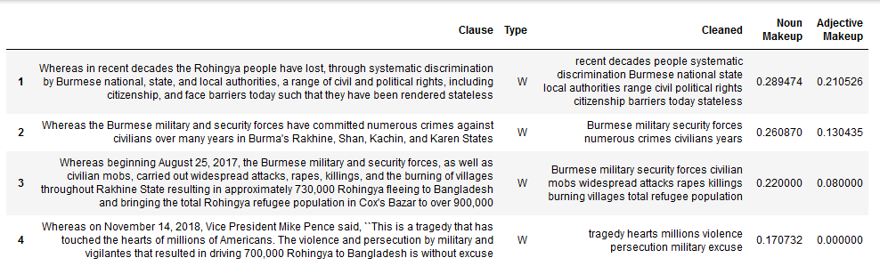
Text Processing and Initial Dataframe Creation (Cont.)
Create dataframe using lists for ‘Clause’ and ‘Type’ features
Use nltk to create list of ‘cleaned’ clauses by iterating through each clause, making them lowercase, removing all stop words, and only leaving nouns and adjectives in the order they appear in the original clause (Necessary for training set creation)
Add cleaned clause list to dataframe
Create noun percentage makeup and adjective percentage makeup features of original clauses

Slide 12
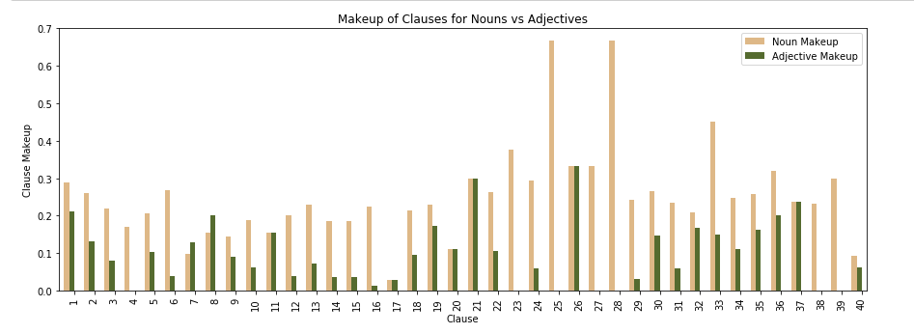
Visualization and Exploration (Dual Bar Chart)

Slide 13
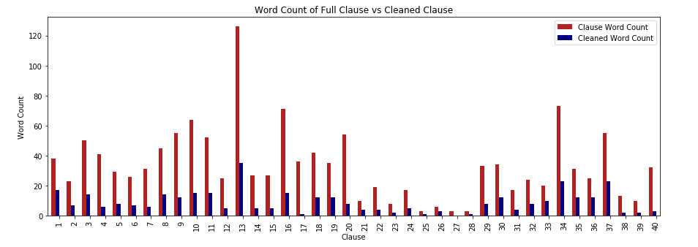
Visualization and Exploration (Dual Bar Chart)

Slide 14
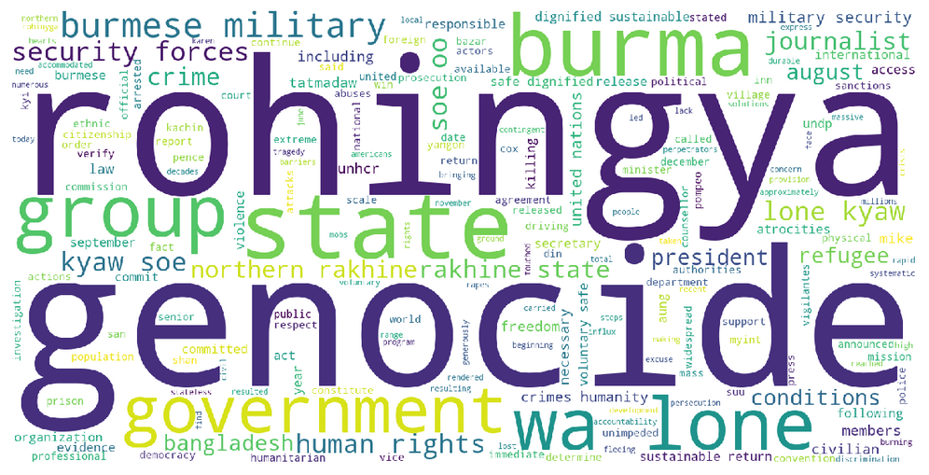
Visualization and Exploration (Wordcloud)

Slide 15
Topic Creation
Using TextRank with n-grams created from a cleaned version of the resolution to determine our topic phrases, equaling the given Topic Amount
TextRank is a graph-based ranking model for text processing used for either finding the most relevant, and thus most important, sentences or key phrases
An n-gram is a sequence of 'n' items taken from a piece of text or speech
Only using 2- and 3-grams
1-grams, being single words, are much too vague to effectively represent a well-defined topic
n-grams with n > 3 are too large and overspecified to act properly as a topic
Collect the top five best ranked 2-grams and 3-grams for topic determination
Sort collected n-grams by rank, take top ‘Topic Amount’ as our topic phrases

Slide 16
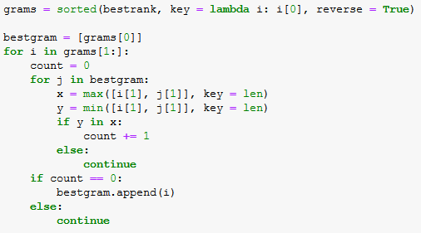
Topic Creation Safeguard
Some testing runs have shown instances of one topic phrase ‘including’ a different topic phrase within itself, which reduces the model’s usefulness
Ex.: ‘Iranian Regime’, ‘Permanent Iranian Regime’
Safeguard iterates through collected n-grams ordered by highest to lowest ranking, and if a lower-ranking phrase is contained in a higher-ranking one or vice versa, it is not considered for final topic consideration

Slide 17
Topic Labeling and Training Set Creation
Create an array for each topic phrase of binary values, with each value corresponding to a clause in index order stating ‘Yes’ or ‘No’ as to if the cleaned clause contains the given topic phrase
Binary values are 0 and an odd number, acting as the topic label of form 1 + 2(n - 1), where ‘n’ indicates the topic phrase’s rank (1st, 2nd, 3rd, etc)
All topic arrays are then added together to create a single array comprised of zeroes, the topic label values, and any combination of them
Summed array is iterated through and any value that is not a zero or topic label value is set back to zero
This is because we want our training set (the clauses we will use to predict the topics of other clauses) to be made up of clauses that represent only one topic
Cleaned summed array is now set as the ‘Topic’ feature in the dataframe

Slide 18
Why Values of 1 + 2(n - 1) and not 1, 2, 3, …?
Say we have Topic Amount = 3 and are using 1, 2, 3 as topic label values
Say that there is a clause with the first and second topic phrases, but not the third
Thus its respective values in each of the original topic arrays would be 1, 2, 0
When summed, the clause would have a value of 3
When the summed array is iterated through, it will be checking for values that aren’t 0, 1, 2, 3 so they can be set back to 0
Because its value is 3, it will not be set back to 0
Not only is a multi-labeled clause remaining in our training set, but it is now labeled as representing the third topic, which it doesn’t, so it is doubly wrong
When using values 1, 3, 5 in this case, it would have a value of 4, which can be set back to 0 without issue

Slide 19
Further Feature Creation via Bag of Words and tf-idf
Using BoW and tf-idf to create a few hundred additional features, where each feature represents a common word, and each cell is a value that is the product of the word’s frequency in the corresponding clause and the weighted value of the clause’s type determined by tf-idf
Bag of Words/BoW Features finds the most common words in a resolution, finds each of their frequencies in each clause, and returns these frequencies as a dataframe
Term frequency-individual document frequency grants us weighted values that are representative of a statistical measure used to evaluate how important a word is to the sections of a resolution
As the count of a word rises, the importance increases proportionally and is offset by the frequency of the word in the overall resolution

Slide 20
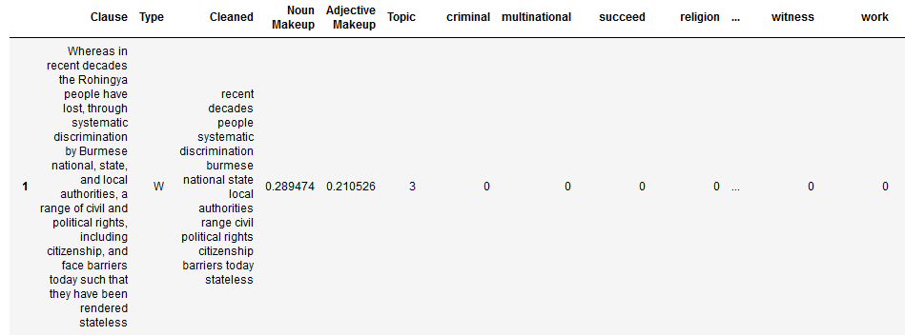
Further Feature Creation via Bag of Words and tf-idf (Cont.)
The original clause and BoW/tf-idf dataframes are now concatenated to create the final, completed dataframe for topic predictions

Slide 21
Topic Predictions
Training and test sets are created manually by setting training sets as clauses with non-zero topic labels and test sets as clauses with zero-value topic label
X sets are all features except original/cleaned clauses and clause type
Y sets are the topic labels
SVM is loaded with tuned parameters best for most resolutions and for making more balanced predictions via balanced class weights despite a likely imbalanced training set
Topic label predictions are made for the test set
Predictions are set as topic label values for unlabeled test set

Slide 22
Why SVM?
SVM was decided as by far the best classifier for the following reasons:
SVM is particularly useful in dealing with very high dimensionality (necessary since we have hundreds of features)
SVM is very effective when the number of features is greater than the number of training observations (hundreds vs often less than ten)
The hyperplane used in SVM is affected by only the support vectors, thus outliers have less impact (necessary since outliers could heavily damage our small training set's usability)
SVM consistently receives much higher validation metrics across various resolutions and Topic Amount values than other classifiers, such as decision trees, random forests, and gradient boosted decision trees

Slide 23
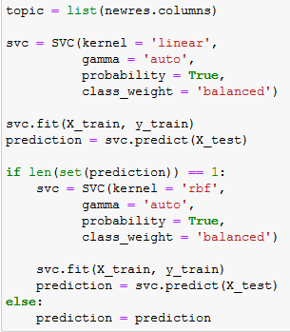
SVM Kernel Underfitting Safeguard
Most resolutions have few enough clauses (sub-50) and relatively balanced enough training sets that ‘linear’ is the best SVM kernel for them
Yet, for some, if those conditions aren’t met, ‘linear’ is very much not the best kernel, causing SVM to heavily underfit and only predict one topic label for the entire test set
Safeguard checks for underfitting by checking if there’s more than one label in prediction, and if not, remakes predictions with ‘rbf’ kernel for much more balanced and useful predictions
rbf predictions receive as strong of metrics as linear predictions

Slide 24
Model Validation: A Small Problem
It’s necessary that we check some metrics to see how efficient SVM was in its predictions, yet with validation metrics, we need the original test set labels and the label predictions, yet we don’t have any original test set labels
If we don’t have any metrics, then we can’t determine how meaningful our final product is
Then we must create a way such that we can see some metrics

Slide 25
Model Validation: The Solution
The solution lies in pseudo-supervised learning
Once we have our full topic label set, simply switch the training and test subsets
Then train off of the newly labeled subset and make predictions for the originally labeled subset
This allows us to create some pseudo-metrics such as accuracy, precision, and recall that allow us a means of quantifying just how well-defined our overall topics are with regard to the features based off the original training set
Metrics are also weighted to consider common topic label imbalance and thus provide us with slightly more meaningful values

Slide 26

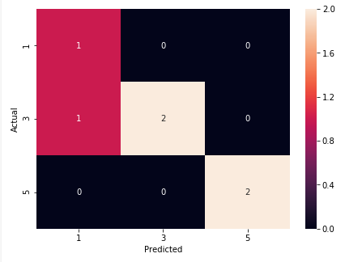
Model Validation: Metrics
All metrics, for recommended Topic Amount value, generally range between 0.8 - 1.0, and going to 0.7 at lowest
For Topic Amount values beyond 4, metrics drop to around 0.7 and drop as the value increases
The confusion matrix helps us to see where particularly SVM may have had issues with under/overfitting or where certain topics were too similar to others feature-wise

Slide 27
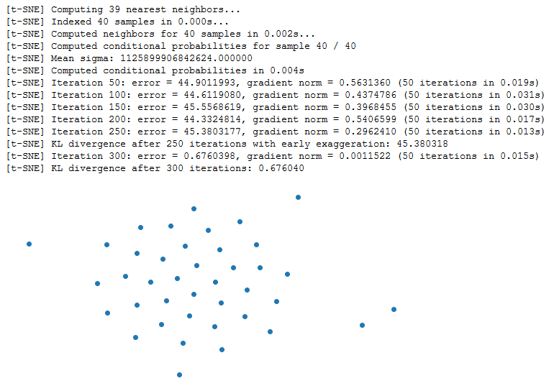
Model Validation: Clustering
Clustering algorithms allow us to visualize how all of our data is grouped
Using a dimensionality reduction algorithm,since we have very high dimensionality, and specifically t-SNE since it preserves local and global structure
Unfortunately can’t see color-labeled image since its pixel dimensions are so large (6 -7 figures each) that it can’t be rendered
Can still see scatterplot for an idea of either how difficult it may have been for SVM to make accurate predictions by investigating for clusters

Slide 28
Final Product Creation
Finally have all of our topic value labels with necessary metrics
Split final dataframe into two: One for ‘Whereas’ clauses and one for ‘Resolved’ Clauses
Use a double-nested for-loop to create a create a topic subset dataframe for each topic in each section
When subset is made, all clauses within are then put into TextRank to determine which clause best represents and thus best summarizes all other clauses of that topic in that section
All best clauses are put into a list

Slide 29
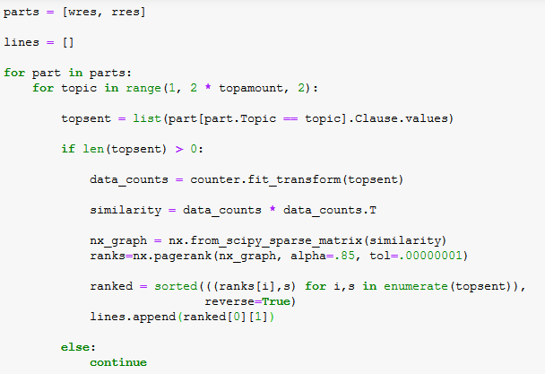
Final Product Creation Safeguard
For Topic Amount values greater than 3, it’s very common for some topics to not have any clauses in one of the sections, and sometimes both due to overfitting
Thus, when creating the topic subsets, an empty dataframe will be made, which will cause an error in TextRank and end the model’s process before the product is returned
The safeguard thus checks the length of the subsets. If non-zero, it’s put into TextRank, and if zero, it’s skipped

Slide 30
Final Product Creation
The best clause list is then ordered by the order they appear in in the resolution and capitalized for formality’s sake
The list of topic phrases, the numbered and ordered summary clauses, and a statement comparing max clauses returned vs amount actually returned is printed as the final product

Slide 31
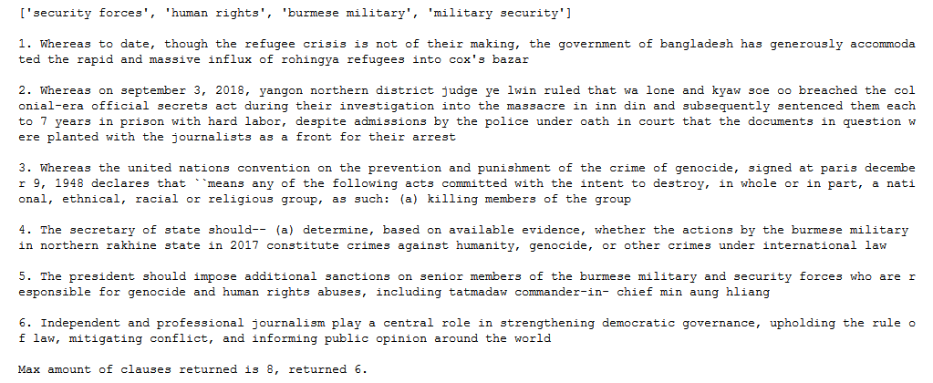
Final Product Example

Slide 32
Afterword

Slide 33
Evaluation of Metrics
SVM models perform with consistently high results
Weakest metrics never fall below 0.7 and generally range between 0.8 - 1.0 for all metrics when using recommended Topic Amount values
Including parameters that balanced out class weights due to topic label imbalances greatly helped in making stronger predictions overall, and thus, stronger metrics in general
Even using Topic Amount values greater than 4 results in relatively acceptable metrics on occasion
Metrics could be raised even further through further work on training set creation method, allowing for more balanced label distribution and a larger training set overall

Slide 34
Evaluation of Safeguards
Safeguards negated all issues of errors upon using multiple different resolutions and running each with different Topic Amount values
Made model able to work with a broader scope of resolutions by adapting to possible issues of over/under fitting caused by certain Topic Amount values and resolution length in terms of clauses
Consistently allows model to return a product, albeit slightly shorter than intended, made to the best of its ability

Slide 35
Future Ideas for Implementation
Extractive Text Summarization
Would replace summary clauses with unique sentences made up of phrasings found within each topic subset
Sentences would be ‘puzzle-pieced’ together to even better represent and summarize topics in each section
More information maintained overall with same amount of items in product
Abstractive Text Summarization
Would replace summary clauses with unique sentences made independently of the clauses in the topic subsets
Sentences are entirely unique as opposed to being ‘puzzle-pieced’
Would entirely remove inherent inaccessibility of legislative writing, which is still semi-present in ETS sentences due to being made of the clauses
More information maintained overall with same amount of items in product

